Slide 1
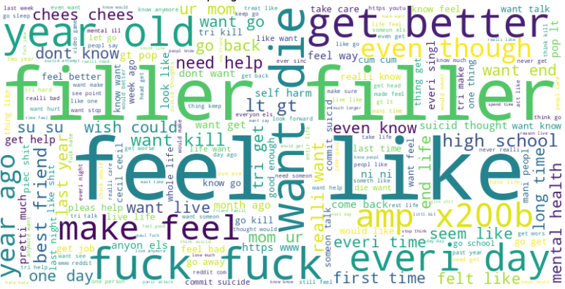
ADIL A., JOHAN J. T., IMAAD M. A., KAYVAN K.
To BI or not to BI?
Presenter: Adil Alizada

Slide 2

What is Suicide?
The W.H.O Definition
“Suicide is the act of deliberately killing oneself.” [1]

Slide 3
Suicide
WHO STATISTICS [2]
  More than 700,000 deaths per year
  People between 15-29 years old
  What can be done?

Slide 4
Suicide Prevention
Emotional Support
- Be supportive
- Avoid being judgemental
Professional Help
- Therapists
- Psychiatrists
- etc.

Slide 5
Suicide Prevention
Emotional Support
- Be supportive
- Avoid being judgemental
Professional Help
- Therapists
- Psychiatrists
- etc.

Slide 6
Suicide Detection
People most openly express their worries on social media [3]

Slide 7
State-Of-The-Art
- Transformers [4], [5]
- BERT
- RoBERTa
- ALBERT
- XLNet
- Deep Learning Architectures [4], [5], [6]
- LSTM
- LSTM-CNN
- Bidirectional TCN

Slide 8
State-Of-The-Art
- Transformers [4], [5]
- BERT
- RoBERTa
- ALBERT
- XLNet
- Deep Learning Architectures [4], [5], [6]
- LSTM
- LSTM-CNN
- Bidirectional TCN

Slide 9
Dataset
- “SuicideWatch” Reddit dataset from Kaggle [7].
- 116,037 Suicidal samples
- 116,037 Non-Suicidal samples
- Utilised in most literature

Slide 10
State-Of-The-Art
Common Pre-Processing steps:
- Case Normalisation [5], [6]
- Stopword Filtering [5], [6]
- Word Stemming [5]
- Tokenization [5]
- URL, Mentions, Punctuations Removal [6]

Slide 11
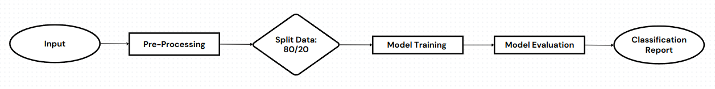
Our Methodology
Direct comparison between Bidirectional, traditional LSTM architectures and transformer variants BERT and RoBERTa

Slide 12
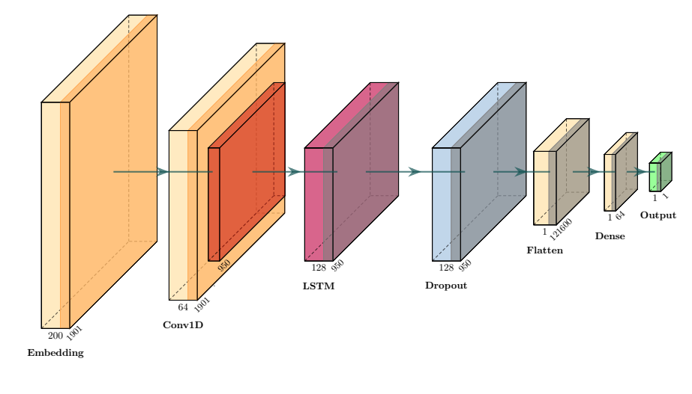
LSTM Architectures
- Same architectures for Bidirectional and Normal LSTMs
- Hybrid architecture utilising Convolutional Layer

Slide 13
Evaluation
- Scikit-learn classification report was used
- 4 metrics:
- Accuracy
- Recall
- Precision
- F1-Score
- Different train/test splits to avoid overfitting

Slide 14
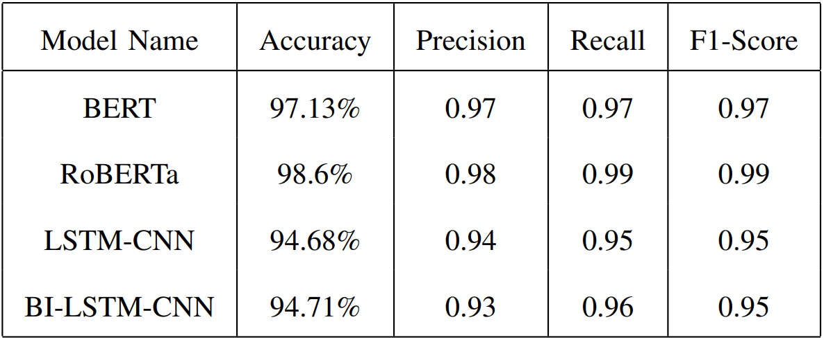
Results
- RoBERTa proved to be the best choice
- No noticable difference between BI and traditional LSTM-CNNs

Slide 15
Limitations and Future Works
Misclassifications
- Model relies too heavily on keywords, such as “suicide”
Dataset
- Might not be labelled well
- Needs to be manually labelled
- Use an LLM for re-labelling?

Slide 16
Limitations and Future Works
Misclassifications
- Model relies too heavily on keywords, such as “suicide”
Dataset
- Might not be labelled well
- Needs to be manually labelled
- Use an LLM for re-labelling?

Slide 17
References
[1] W. H. O., “Suicide.” [Online]. Available: https://www.emro.who.int/health-topics/suicide/feed/rss.html
[2] W. H. O., “Suicide.” [Online]. Available: https://www.who.int/news-room/fact-sheets/detail/suicide
[3] R. Chiong, G. S. Budhi, S. Dhakal, and F. Chiong, “A textual-based featuring approach for depression detection using machine learning classifiers and social media texts,” Computers in Biology and Medicine, vol. 135, p. 104499, Aug. 2021. [Online]. Available: https://linkinghub.elsevier.com/retrieve/pii/S0010482521002936
[4] F. Haque, R. U. Nur, S. A. Jahan, Z. Mahmud, and F. M. Shah, “A transformer based approach to detect suicidal ideation using pre-trained language models,” 2020 23rd International Conference on Computer and Information Technology (ICCIT), p. 1–5, Dec. 2020. [Online]. Available: https://ieeexplore.ieee.org/document/9392692/
[5] Z. Wang, M. Jin, and Y. Lu, “High-precision detection of suicidal ideation on social media using bi-lstm and bert models,” in Cognitive Computing – ICCC 2023, X. Pan, T. Jin, and L.-J. Zhang, Eds. Cham: Springer Nature Switzerland, 2024, p. 3–18.
[6] S. L. Mirtaheri, S. Greco, and R. Shahbazian, “A self-attention tcn-based model for suicidal ideation detection from social media posts,” Expert Systems with Applications, vol. 255, p. 124855, Dec. 2024. [Online]. Available: https://www.sciencedirect.com/science/
article/pii/S0957417424017226
[7] “Reddit dataset.” [Online]. Available: https://www.kaggle.com/datasets/nikhileswarkomati/suicide-watch

Slide 18
Contacts
Adil Alizada,
Undergraduate Researcher and Lab Assistant,
Heriot-Watt University Dubai
Email Address
aa2130@hw.ac.uk

